Slide 1
Introduction to C++

Slide 2
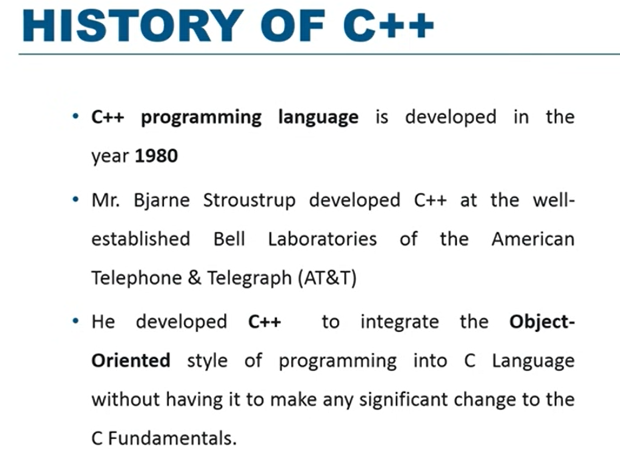

Slide 3
Why C++
C++ is one of the world's most popular programming languages.
C++ can be found in today's operating systems, Graphical User Interfaces, and embedded systems.
C++ is an object-oriented programming language which gives a clear structure to programs and allows code to be reused, lowering development costs.
C++ is portable and can be used to develop applications that can be adapted to multiple platforms.
As C++ is close to C, C# and Java, it makes it easy for programmers to switch to C++ or vice versa.

Slide 4
myfirstprog.cpp
C++ Quickstart
Let's create our first C++ file.
Open Codeblocks and go to File > New > Empty File.
Write the following C++ code and save the file as myfirstprogram.cpp
#include <iostream> using namespace std; int main() { cout << "Hello World!"; return 0; }

Slide 5
#include <iostream> using namespace std; int main() { cout << "Hello World! \n\n"; cout << "I am learning C++"; return 0; }

Slide 6
C++ Comments
Comments can be used to explain C++ code, and to make it more readable. It can also be used to prevent execution when testing alternative code. Comments can be singled-lined or multi-lined.
Single-line Comments
Single-line comments start with two forward slashes (//).
Any text between // and the end of the line is ignored by the compiler (will not be executed). C++ Multi-line Comments
Multi-line comments start with /* and ends with */.

Slide 7
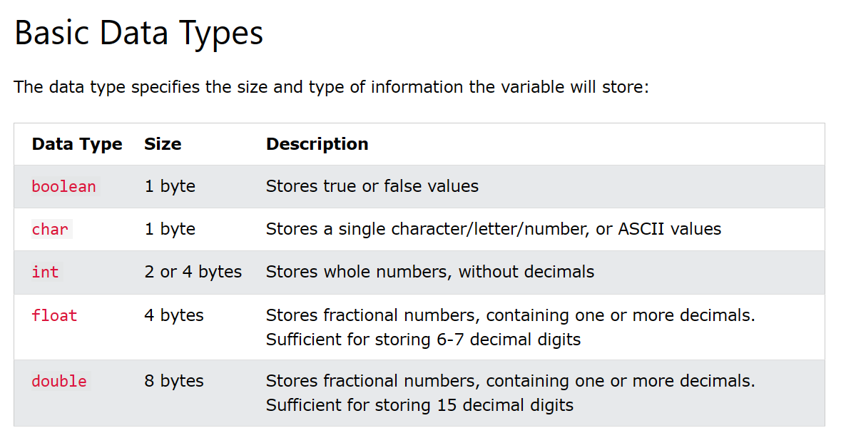

Slide 8
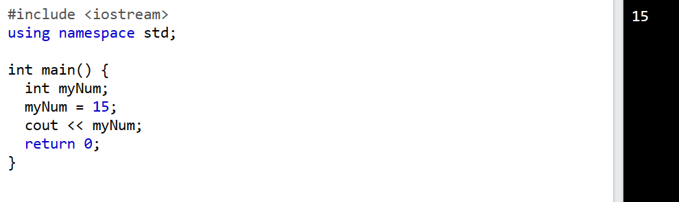

Slide 9
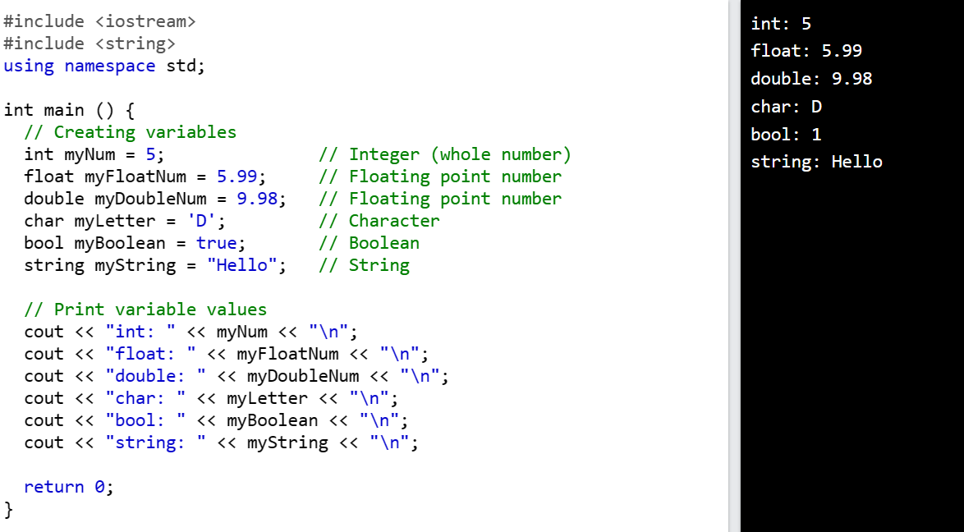

Slide 10
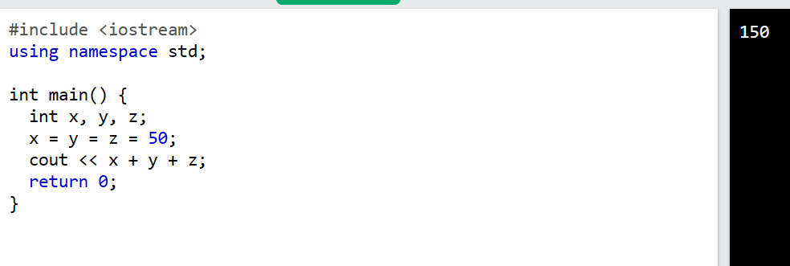
One Value to Multiple variables

Slide 11
C++ User Input
You have already learned that cout is used to output (print) values. Now we will use cin to get user input.
cin is a predefined variable that reads data from the keyboard with the extraction operator (>>).

Slide 12
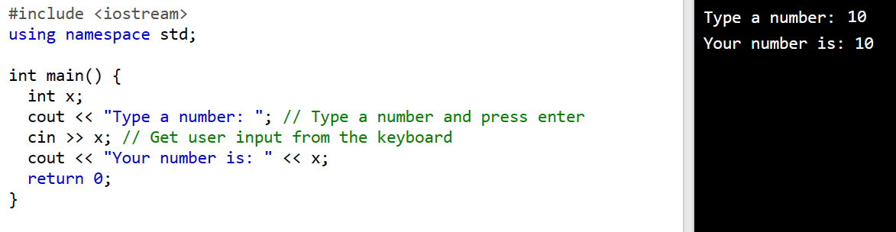

Slide 13
Operators
Arithmetic operators
Assignment operators
Comparison operators
Logical operators
Bitwise operators

Slide 14
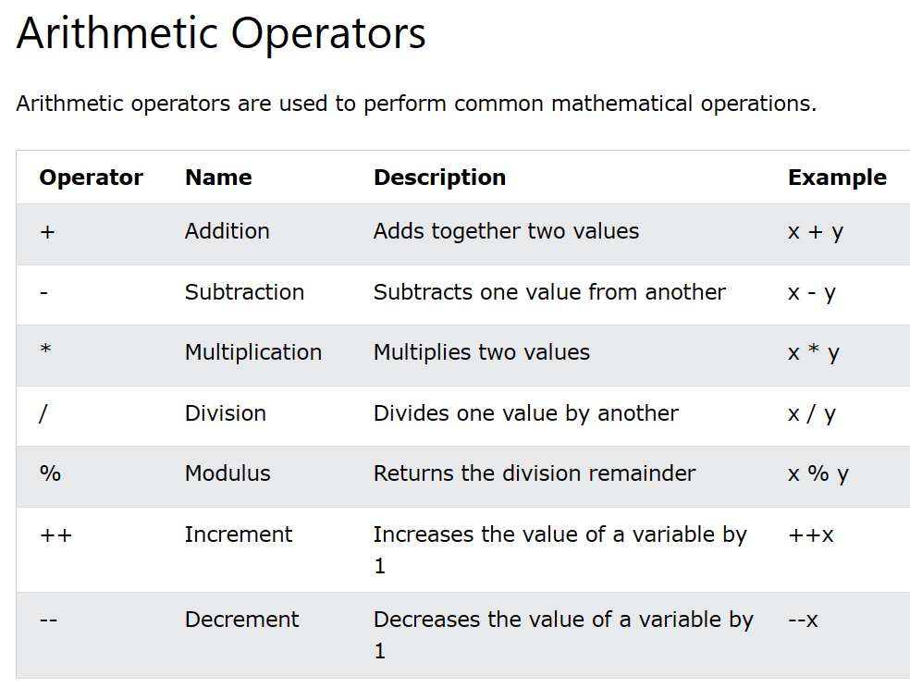

Slide 15
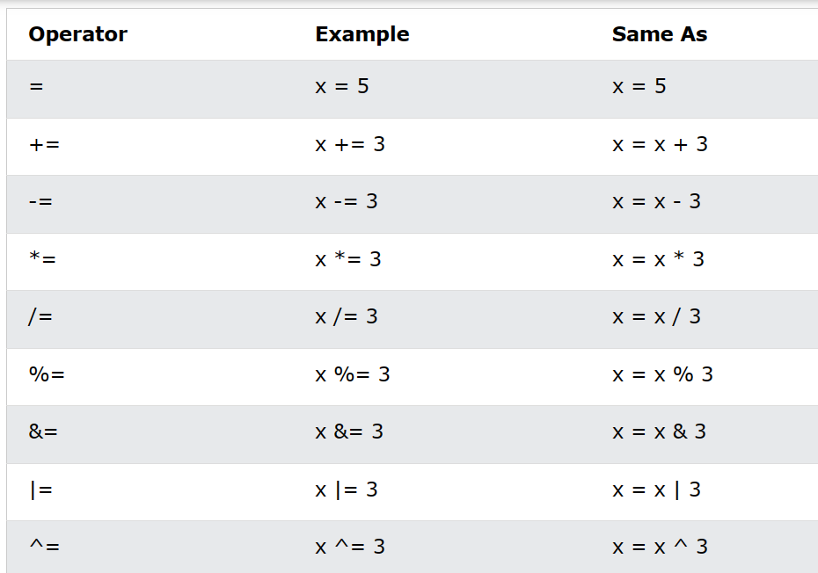

Slide 16
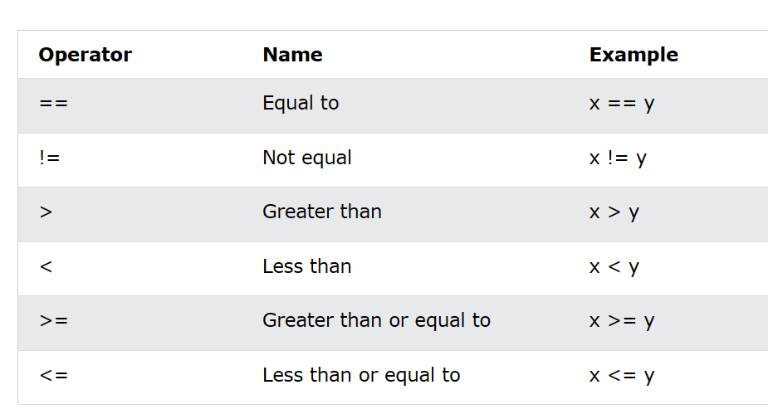

Slide 17
